Slide 1
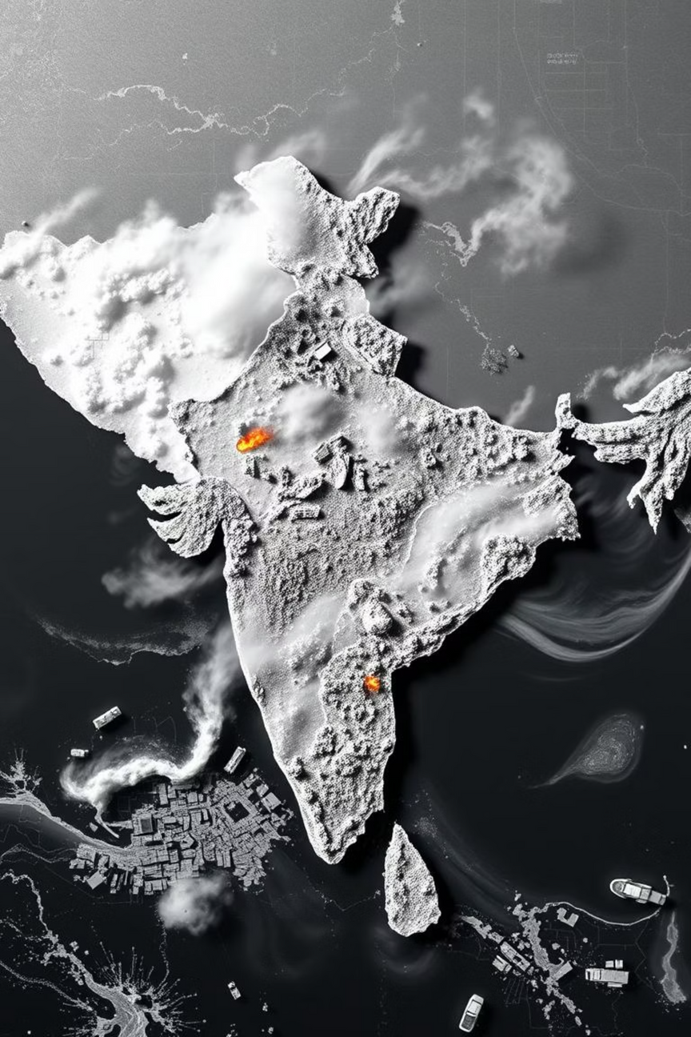

Multi-Sensor Disaster Detection & Early Warning System
Leveraging Prithvi-100M with Stubble Burning Monitoring for India.
Notes:
1

Slide 2
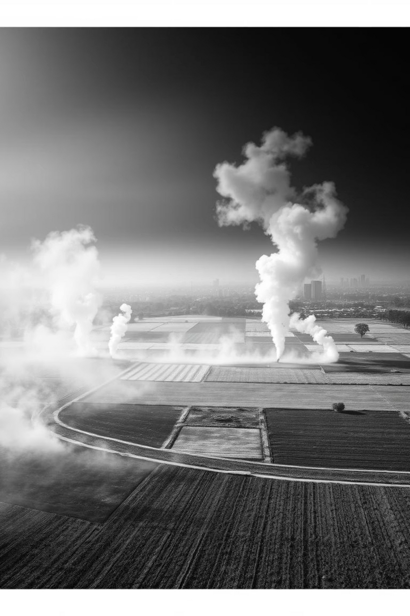
Introduction
Addressing India's Environmental Challenges
India faces annual economic losses exceeding USD 5 billion and endangers over 75 million people due to recurrent floods, landslides, forest fires, and agricultural stubble burning. Stubble burning alone contributes up to 40% of Delhi's PM2.5 pollution during post-harvest seasons.
Current monitoring systems often rely on single-sensor imagery or pre-trained convolutional networks, which generalize poorly. Our project proposes a transformative alternative using IBM–NASA's open-source Prithvi-100M geospatial foundation model.
Notes:
2

Slide 3
Problem Statement
Gaps in Current Disaster Monitoring
Delayed Alerts
Single-Modal Limitations
Disaster products arrive 24–72 hours after events, limiting effective response to flash floods or rapidly spreading fires.
Existing models struggle with cloud cover, night-time acquisitions, and agricultural areas due to their single-modal nature (optical or SAR).
Stubble Burning Evasion
Lack of Unified Prithvi-100M
Farmers time burns to avoid satellite overpass, leading to 45% false negatives in current detection systems.
No fine-tuned Prithvi-100M implementation for Indian conditions that fuses multi-sensor imagery with weather forecasts for all four disaster types.
Notes:
3

Slide 4
Objectives
Our Goals for Enhanced Detection
1
Fine-Tune Prithvi-100M
Achieve high accuracy for flood extent (IoU ≥ 0.85), landslide (F1 ≥ 0.80), fire detection (precision ≥ 0.90), and stubble burning (accuracy ≥ 0.85).
2
Modular Pipeline Design
Ingest multi-sensor data (Sentinel-1/2, VIIRS, IMD, DEM) to produce hourly hazard maps at 30m resolution.
3
Late-Afternoon Monitoring
Implement geostationary monitoring (GEO-KOMPSAT/INSAT-3DR) to capture stubble burns after polar-orbiting satellite overpass.
4
Web-Based GIS Dashboard
Develop a dashboard and alert module for <15 min latency from image availability to warning issuance.
5
Evaluate Social Impact
Pilot with SDMA in Uttarakhand and Punjab Pollution Control Board to assess improved preparedness.
Notes:
4

Slide 5
Methodology
Technology Stack and Data Flow
Data Ingestion
Sentinel-2 L2A, Sentinel-1 GRD, VIIRS 375m FRP, HLS L30/S30, IMD now-casts, 30m DEM, geostationary imagery
AWS S3, COP-Hub, GEE, IMD API, LANCE FIRMS
ESA, NASA, ISRO, NOAA
Pre-processing
Atmospheric correction, speckle filtering, FRP calibration, co-registration, bilinear resampling to 30m
GDAL, Rasterio, PySAR, SNAP
—
Model Fine-Tuning
Transfer-learn Prithvi-100M encoder; specialized decoder heads; mixed-precision training
PyTorch, Hugging Face Transformers, TerraTorch
Sen1Floods11, Landslide4Sense, FireCCI-51, Punjab stubble data
Stubble Detection Module
Multi-temporal burn scar analysis, FRP threshold adaptation, late-afternoon monitoring
OpenCV, Scikit-learn
VIIRS FRP, Agricultural census, Crop calendar
Real-Time Inference
Sliding-window tiling, ONNX export for GPU inference, ensemble post-processing
FastAPI, CUDA, TensorRT
Near-real-time imagery
Alert Fusion
Threshold logic with IMD rainfall & wind forecasts, air quality impact modeling
Pandas, NumPy, WRF-Chem
IMD NWP, CPCB AQI stations
Visualisation & Dissemination
React + Leaflet dashboard, Mapbox GL JS, Twilio/WhatsApp API, PM2.5 impact zones
Docker, AWS EC2/S3
—
Notes:
5

Slide 6
Literature Survey
Foundational Research & Key Contributions
2023
Jakubik et al. "Foundation Models for Generalist Geospatial AI"
Introduces Prithvi-100M architecture, our backbone.
2024
Roy et al. "Prithvi-EO-2.0: Multi-Temporal Foundation Model"
Guides our fine-tuning strategy with 8% GEO-Bench gain.
2024
Ranjan et al. "Stubble Burning Detection using Geospatial Foundation Model"
Informs our approach to Punjab stubble detection.
2022
Walker et al. "Detecting Crop Burning in India using Satellite Data"
Establishes baseline metrics with 82% accuracy.
2018
Liu et al. "Intercomparison of MODIS AQUA and VIIRS I-Band Fires"
Guides sensor selection; VIIRS detects 4.8× more agricultural fires.
2025
Szwarcman et al. "Prithvi-EO-2.0 Technical Report"
Informs target metrics for flood mapping and landslide detection.
Additional studies on late-afternoon burning evasion, FRP-based emission quantification, and multi-sensor wildfire detection underscore current limitations that our unified foundation-model approach with geostationary integration aims to overcome.
Notes:
6

Slide 7







Expected Outcomes
Transforming Disaster Response
Operational Prototype
Open Stubble Burning Dataset
Air Quality Impact Prediction
30m hazard maps within 1 hour of satellite overpass; <45 min latency for stubble burning alerts.
Multi-temporal dataset for Punjab-Haryana (2019-2025) with ground-truth validation, openly released.
Correlating stubble FRP with downwind PM2.5 concentrations using WRF-Chem modeling.
Open-Source Resources
Quantitative Performance
Policy Recommendations
Fine-tuning scripts and model checkpoints released on Hugging Face to catalyze research.
≥30% latency reduction and ≥10% accuracy gain over baselines, reducing 45% false negatives in stubble detection.
Evidence-based penalties and targeted subsidy distribution for in-situ stubble management.
Stakeholder Feedback
Improved preparedness workflows and air quality management from SDMA and Punjab Pollution Control Board.
Notes:
7

Slide 8

Conclusion
A Comprehensive Multi-Hazard System
This project leverages the state-of-the-art Prithvi-100M foundation model to create a comprehensive multi-sensor, multi-hazard early-warning system addressing India's most pressing environmental challenges: floods, landslides, forest fires, and agricultural stubble burning.
The inclusion of geostationary monitoring for stubble burning addresses critical gaps in current satellite-based approaches that miss late-afternoon burning activities. By fusing optical, radar, FRP, and meteorological data through a scalable cloud-native pipeline, the system provides immediate disaster response and long-term environmental monitoring.
Notes:
8

Slide 9
Conclusion
Technical Innovation Highlights
1
2
First Multi-Hazard Prithvi-100M Application
Novel Polar-Orbiting & Geostationary Fire Detection
Tailored for Indian conditions, integrating diverse disaster types.
Seamlessly combines data from different satellite types for comprehensive coverage.
3
4
Real-Time Air Quality Impact Modeling
Automated Policy-Relevant Stubble Burning Intelligence
Predicts PM2.5 concentrations from agricultural burning in real-time.
Provides precise, actionable data for policy enforcement and interventions.
Notes:
9

Slide 10
Thank You
Prepared by: Riya, Nipun, Garvit
B.Tech IT, 7th Semester
Department of Information Technology
Maharaja Surajmal Institute of Technology
Notes:
10

